Slide 1
Research Intro
Changjian (CJ) Zhang

Slide 2
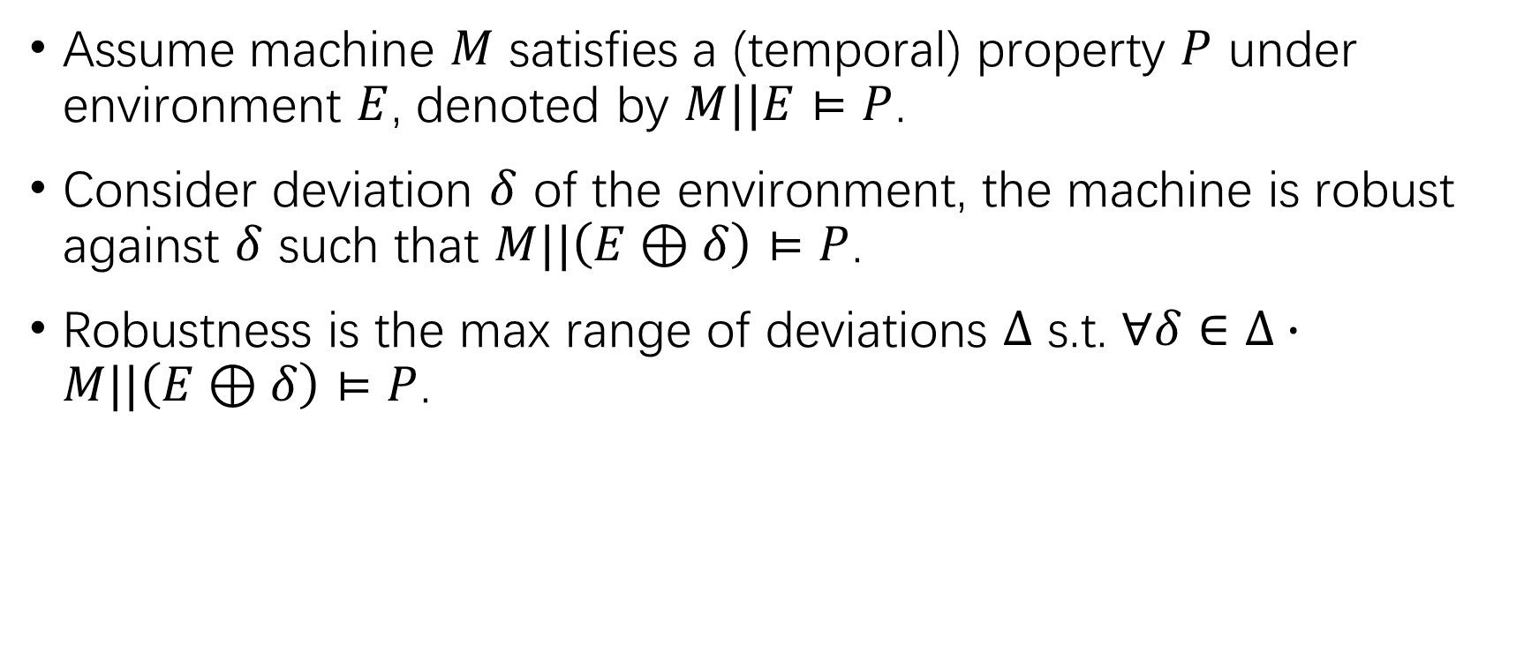
Software Robustness
Assume machine $M$ satisfies a (temporal) property $P$ under environment $E$, denoted by $M||E⊨P$.
Consider deviation $δ$ of the environment, the machine is robust against $δ$ such that $M||\left(E⊕δ\right)⊨P$.
Robustness is the max range of deviations $Δ$ s.t. $∀δ∈Δ∙M||\left(E⊕δ\right)⊨P$.

Slide 3
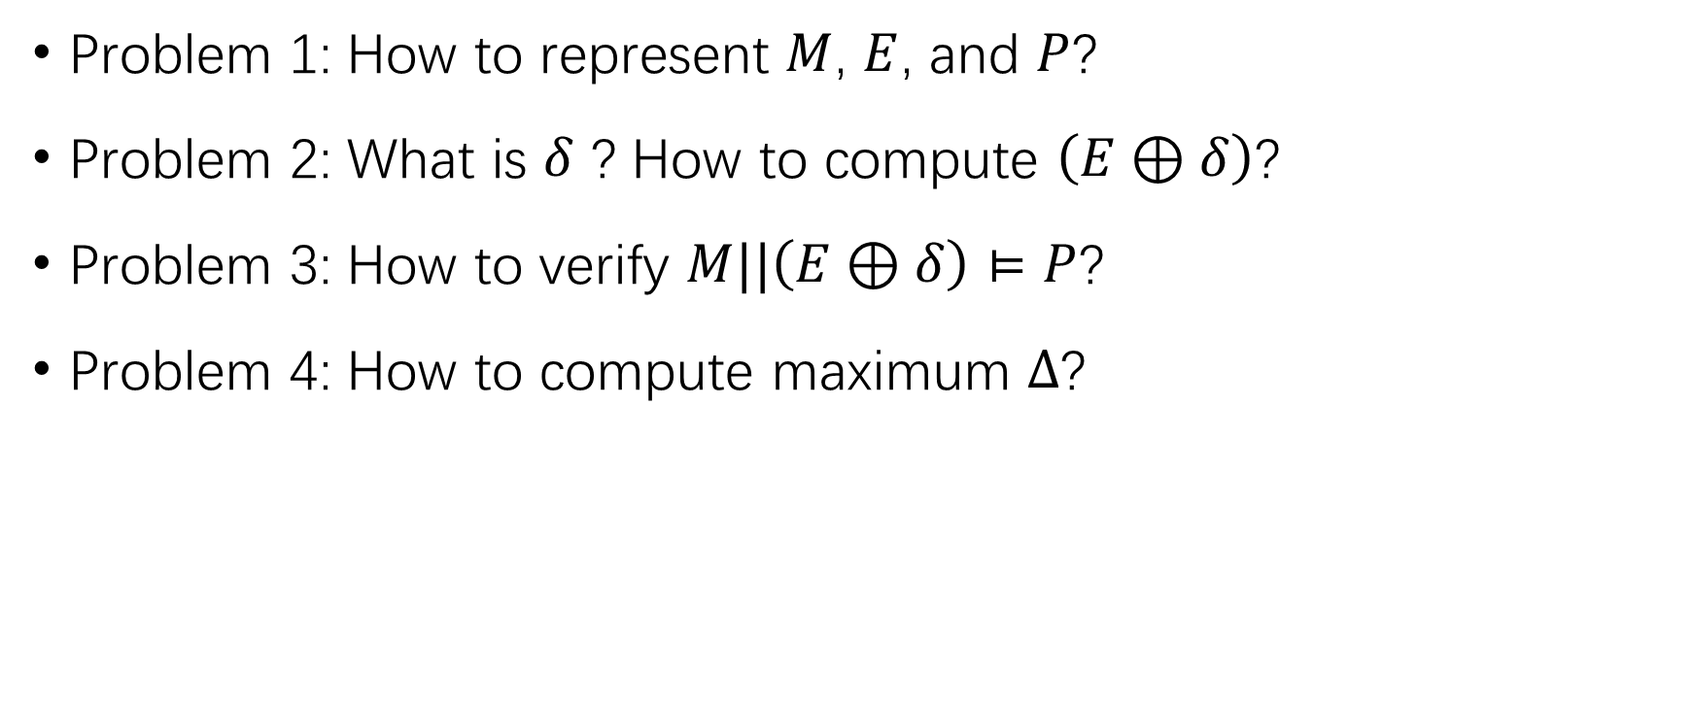
Compute Robustness
Problem 1: How to represent $M$, $E$, and $P$?
Problem 2: What is $δ$ ? How to compute $\left(E⊕δ\right)$?
Problem 3: How to verify $M||\left(E⊕δ\right)⊨P$?
Problem 4: How to compute maximum $Δ$?

Slide 4
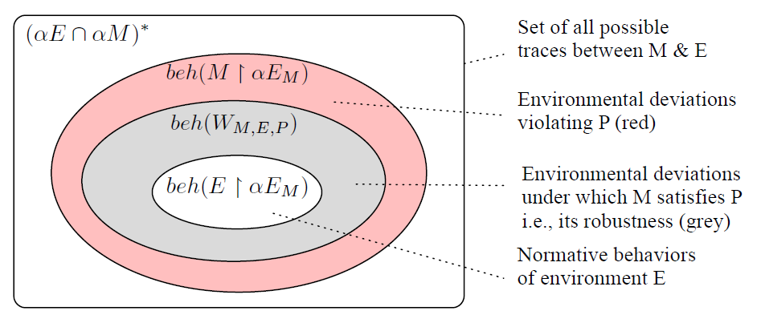

Robustness for System in LTS
$M$ and $E$ are modeled in LTS.
$P$ is a safety property in LTS.
$δ$ is a set of traces.
$Δ$ is the maximum set of traces s.t. $P$ is still satisfied.

Slide 5
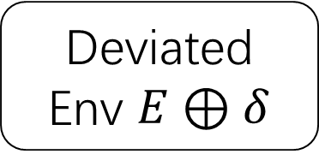
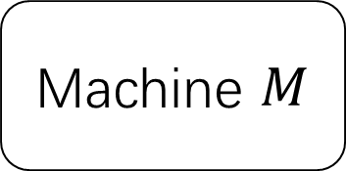

Robustification of Systems in LTS with Supervisory Control
Machine $M$
Deviated Env $E⊕δ$
$$⊭P$$

Slide 6
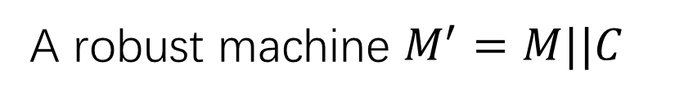
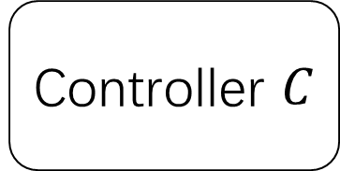

Robustification of Systems in LTS with Supervisory Control
Controller $C$
$$⊨P$$
Machine $M$
Deviated Env $E⊕δ$
A robust machine $M^{′}=M||C$

Slide 7
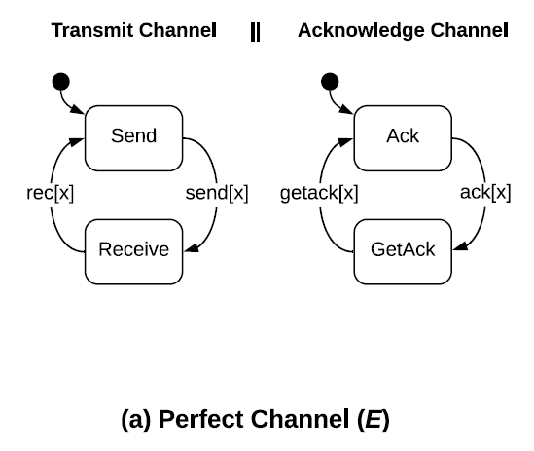
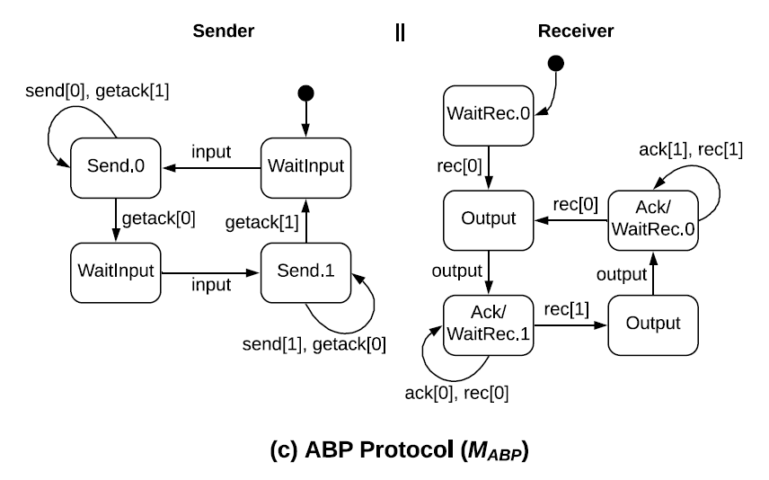
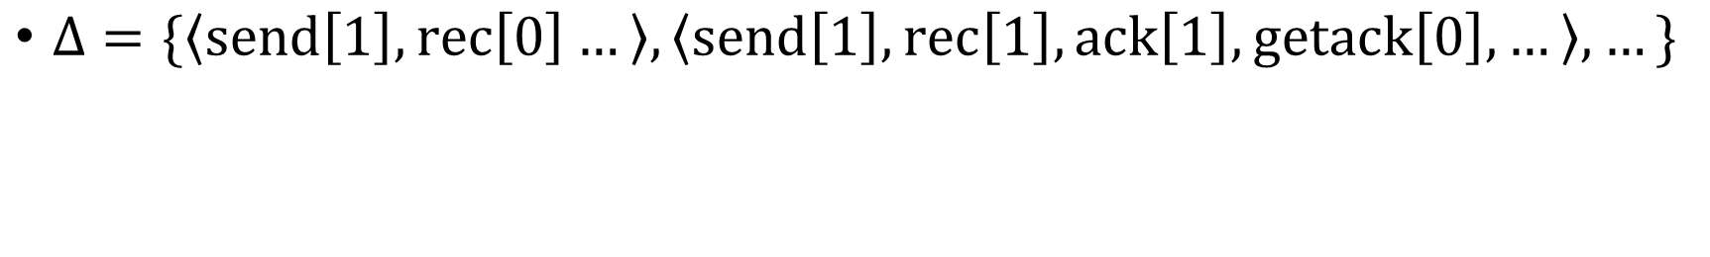
Robustness for System in LTS
$Δ=\{\left\langle send\left[1\right], rec\left[0\right]…\right\rangle ,\left\langle send\left[1\right], rec\left[1\right],ack\left[1\right],getack\left[0\right],…\right\rangle ,…\}$

Slide 8
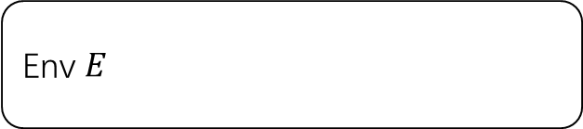
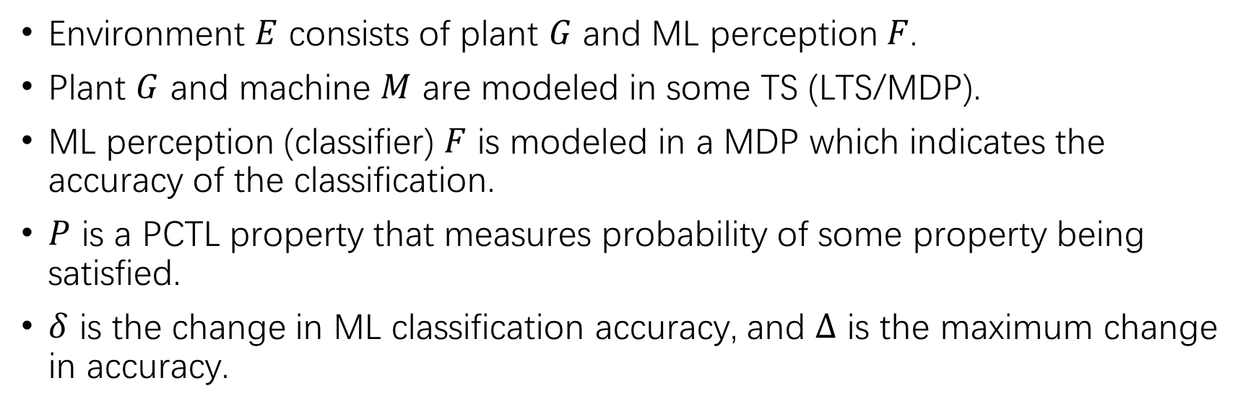

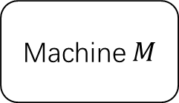

Robustness for System with ML Perception
Env $E$
Machine $M$
Plant $G$
ML Perception $F$
Environment $E$ consists of plant $G$ and ML perception $F$.
Plant $G$ and machine $M$ are modeled in some TS (LTS/MDP).
ML perception (classifier) $F$ is modeled in a MDP which indicates the accuracy of the classification.
$P$ is a PCTL property that measures probability of some property being satisfied.
$δ$ is the change in ML classification accuracy, and $Δ$ is the maximum change in accuracy.

Slide 9
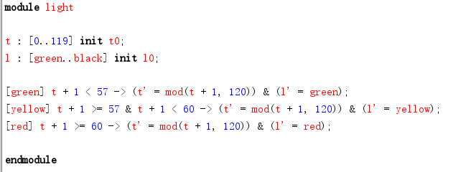
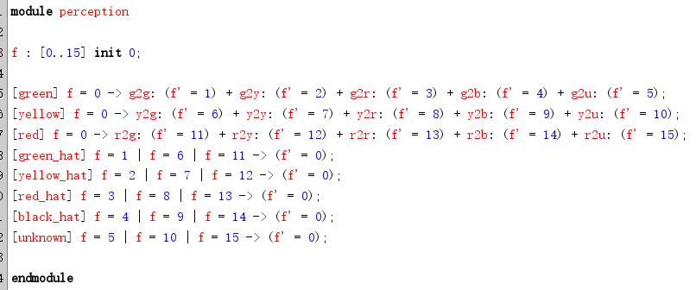
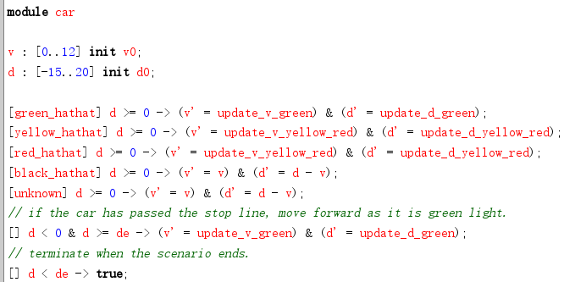
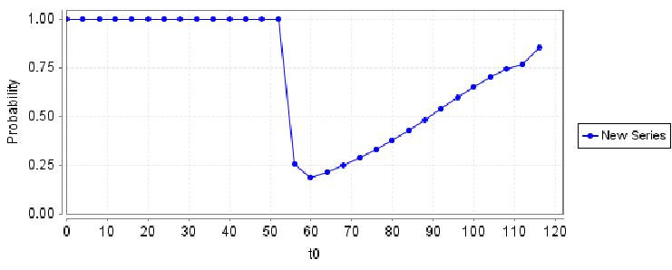
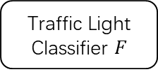
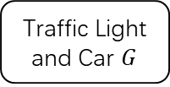
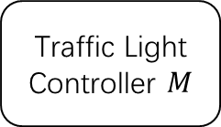
Robustness for System with ML Perception
Env $E$
Traffic Light Controller $M$
Traffic Light and Car $G$
Traffic Light Classifier $F$

Slide 10
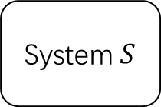
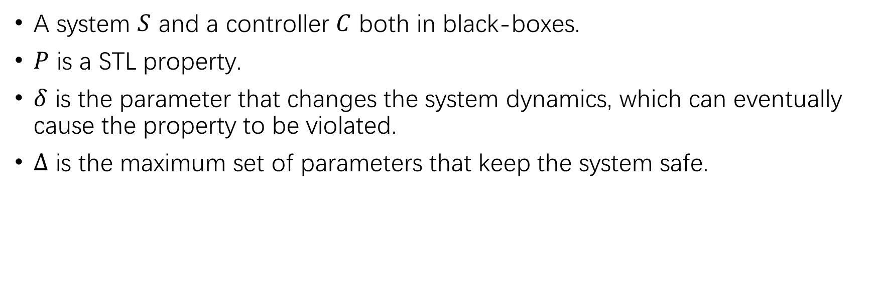
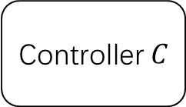
Robustness for (RL) Control System
System $S$
Controller $C$
A system $S$ and a controller $C$ both in black-boxes.
$P$ is a STL property.
$δ$ is the parameter that changes the system dynamics, which can eventually cause the property to be violated.
$Δ$ is the maximum set of parameters that keep the system safe.

Slide 11
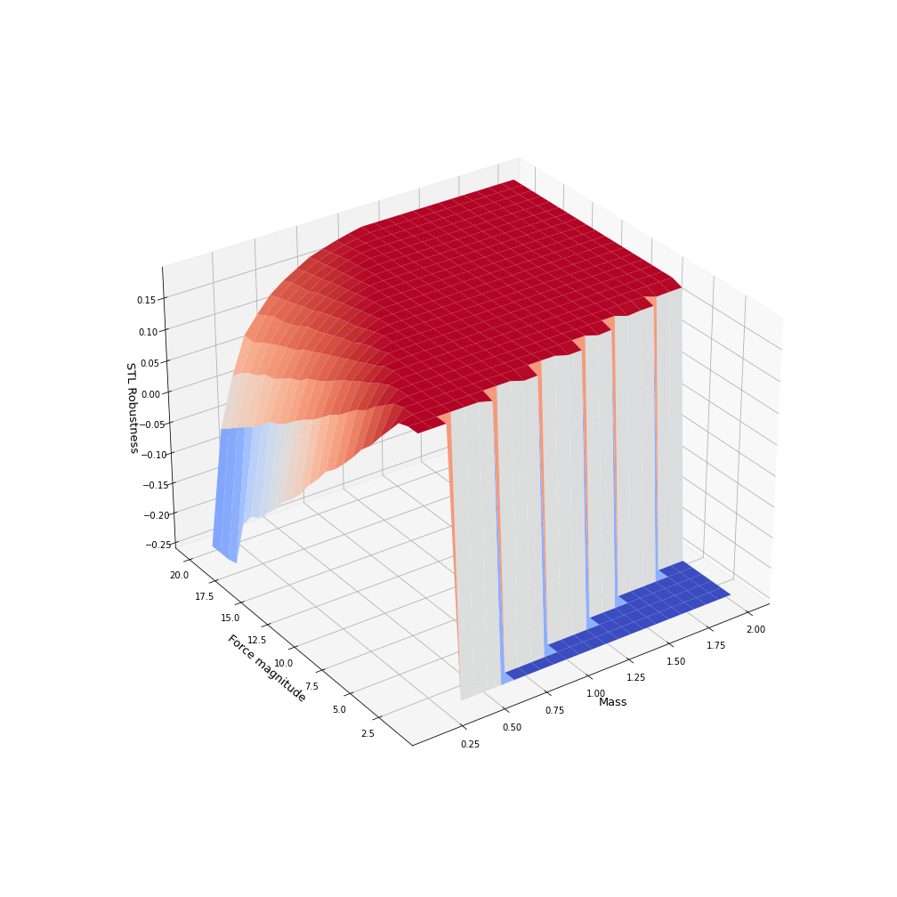
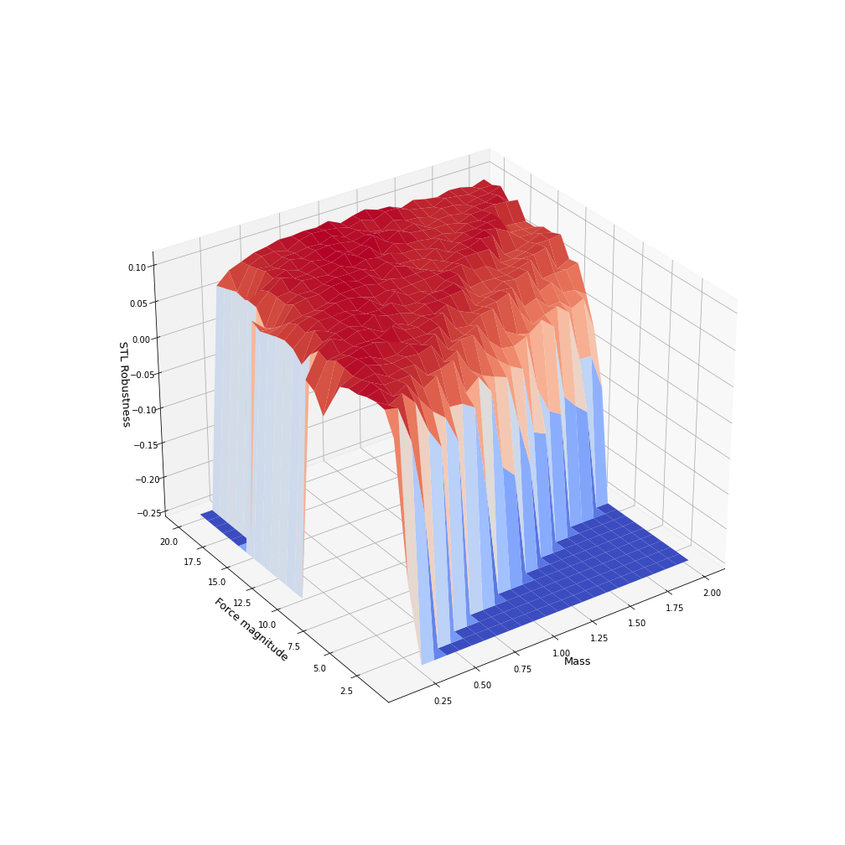
Robustness for (RL) Control System
(a) PID
(b) DQN

Slide 12



AlloyMax: Bringing Maximum Satisfaction to Relational Specifications
Changjian (CJ) Zhang, Ryan Wagner, Pedro Orvalho
David Garlan, Vasco Manquinho, Ruben Martins, Eunsuk Kang
Notes:
Hello everyone, my name is CJ. In this talk, I’ll briefly introduce our work AlloyMax: Bringing Maximum Satisfaction to Relational Specifications. This a joint work of researchers from Carnegie Mellon University and Institute of Systems and Computers Engineering in Lisbon.

Slide 13
What is Alloy?
Alloy: a first-order relational logic modeling language and analyzer.
Use cases:
Design Analysis: assert the behaviors of a system satisfy some property.
Model generation: generate a model satisfying some constraints.
Workflow:
Spec $S$ in FOL
Spec 𝑆 in FOL
SAT Problem
A model $M⊨S$
A model 𝑀⊨𝑆
Notes:
Alloy is a modeling language based on first-order relational logic. With its model analyzer, a FOL problem is translated into a Boolean Satisfiability problem and is solved by an off-the-shelf SAT solver. It is widely used in:
First, design analysis, for example, we can use Alloy to model the behavior of a system, and then verify that certain properties are satisfied.
Second, model generation: for example, we can use Alloy to generate a model that satisfies some given constraints.

Slide 14
Example: Course Scheduling
A course scheduling system:
Each student must take at least 3 courses;
Each student must take all their core courses;
A student must not take courses whose lecture times conflict.
Notes:
Let’s go through an example! Suppose we are building a course scheduling system where:
First, Each student must take at least 3 courses, and Second, each student must take all their core courses, finally, a student must not take courses whose lecture times conflict.

Slide 15

An arbitrary valid solution
 | Mon | Tue | Wed | Thu | Fri
AM | CS101 | ML/Compiler | CS101 | ML/Compiler
PM | SE | OS | SE | OS | CS101
Alloy:
run {
validSchedule[courses]
}
Core course: CS101
Alice
Predicate for the 3 requirements
Notes:
Now, suppose the CS department of CMU is offering 5 courses. And we have a student Alice who must take CS101 as a core course. We can use Alloy to generate a valid but arbitrary solution, i.e., the predicate which defines the three requirements should be true.

Slide 16
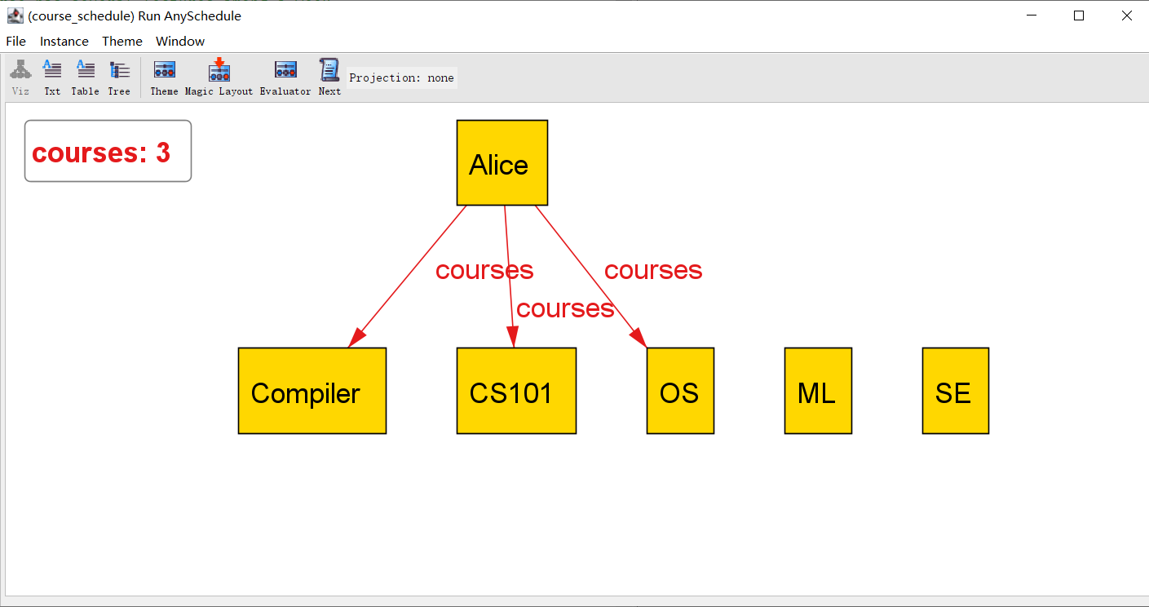
An arbitrary valid solution
 | Mon | Tue | Wed | Thu | Fri
AM | CS101 | ML/Compiler | CS101 | ML/Compiler
PM | SE | OS | SE | OS | CS101
Alloy:
run {
validSchedule[courses]
}
Core course: CS101
Alice
Predicate for the 3 requirements
Notes:
By running the analyzer, it returns a solution that Alice could take CS101, Compiler, and OS. And here’s a screenshot from Alloy.

Slide 17
Maximizing students’ interests
 | Mon | Tue | Wed | Thu | Fri
AM | CS101 | ML/Compiler | CS101 | ML/Compiler
PM | SE | OS | SE | OS | CS101
Alloy:
Interests: ML and SE
Alloy cannot solve this optimization problem!
Alice
Notes:
Then, suppose we also model the personal course preferences into the system, and Alice is interested in ML and SE. We expect the system to generate a solution that satisfies the course requirements and also maximizes students’ interests.
This becomes an optimization problem, that is we want to maximize the number of registered courses that a student is interested in. However, Alloy cannot solve such an optimization problem.

Slide 18
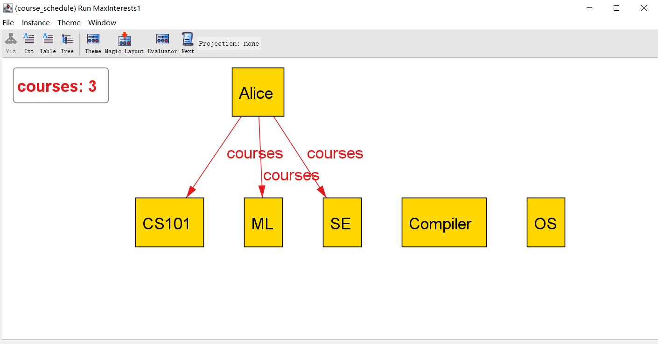
Maximizing students’ interests
 | Mon | Tue | Wed | Thu | Fri
AM | CS101 | ML/Compiler | CS101 | ML/Compiler
PM | SE | OS | SE | OS | CS101
Our extension:
run {
validSchedule[courses]
all s: Student | maxsome s.interests & s.courses
}
Interests: ML and SE
Alice
Maximizing the interests!
Notes:
In our extension, we can solve this problem by adding a new expression, i.e., for any student, there should be some courses that the student is interested in are registered. Moreover, we introduce the new keyword maxsome indicating that it should maximize these courses for each student. By solving this problem, our extension returns a solution where both ML and SE are registered. Here’s the screenshot from our extension where ML and SE are registered.

